Slide 1
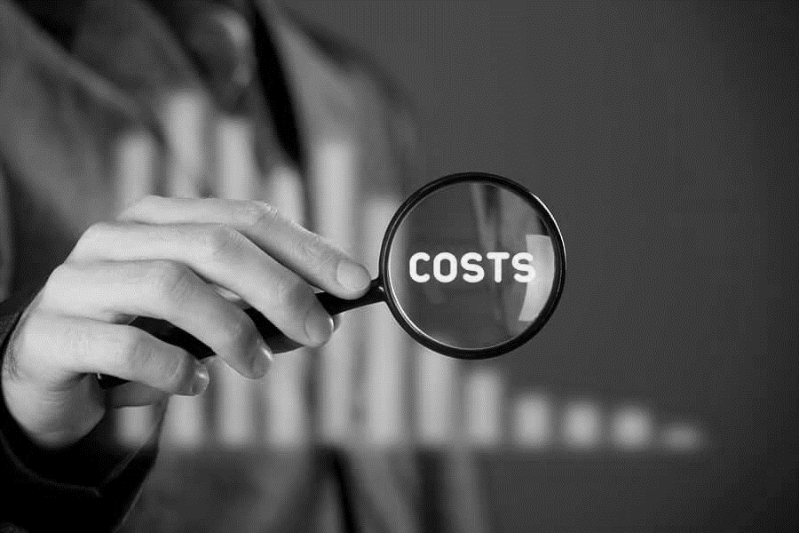
Azure Cost Management.

Slide 2

Martijn Brant.
Cloud Architect - Azure
Works at Portiva, based in the Netherlands
Certified Azure Architect
Focus on infra solutions and app modernization
@MartijnBrant

Slide 3
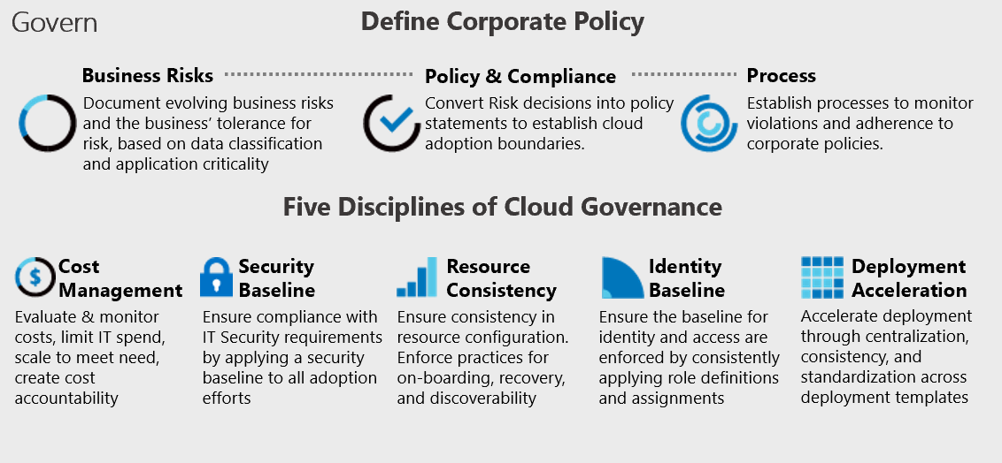
Cost Management.
Part of the Azure Governance Framework

Slide 4
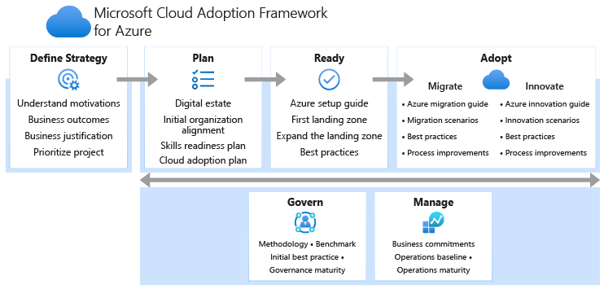
Azure Governance.
Part of the Cloud Adoption Framework

Slide 5
Cost Control.
Controlling cost of your Azure resources
Cost Analysis
Budgets
Alerting
Tagging

Slide 6
Cost Optimization.
Reducing cost of your Azure resources
Move to SaaS
Optimize to PaaS
Hybrid Use Benefit
Right sizing (Azure Advisor)
Reserved instances
Turn off resources by automation

Slide 7
Cost Optimization.
Reducing cost of your Azure resources
Type of subscription
Azure Region (within latency/governance)
Burstable VMs
Storage SKU (speed vs SLA)
Azure Spot (low cost instances)
Azure Batch (low priority VM)

Slide 8
Demo time!

